Slide 1
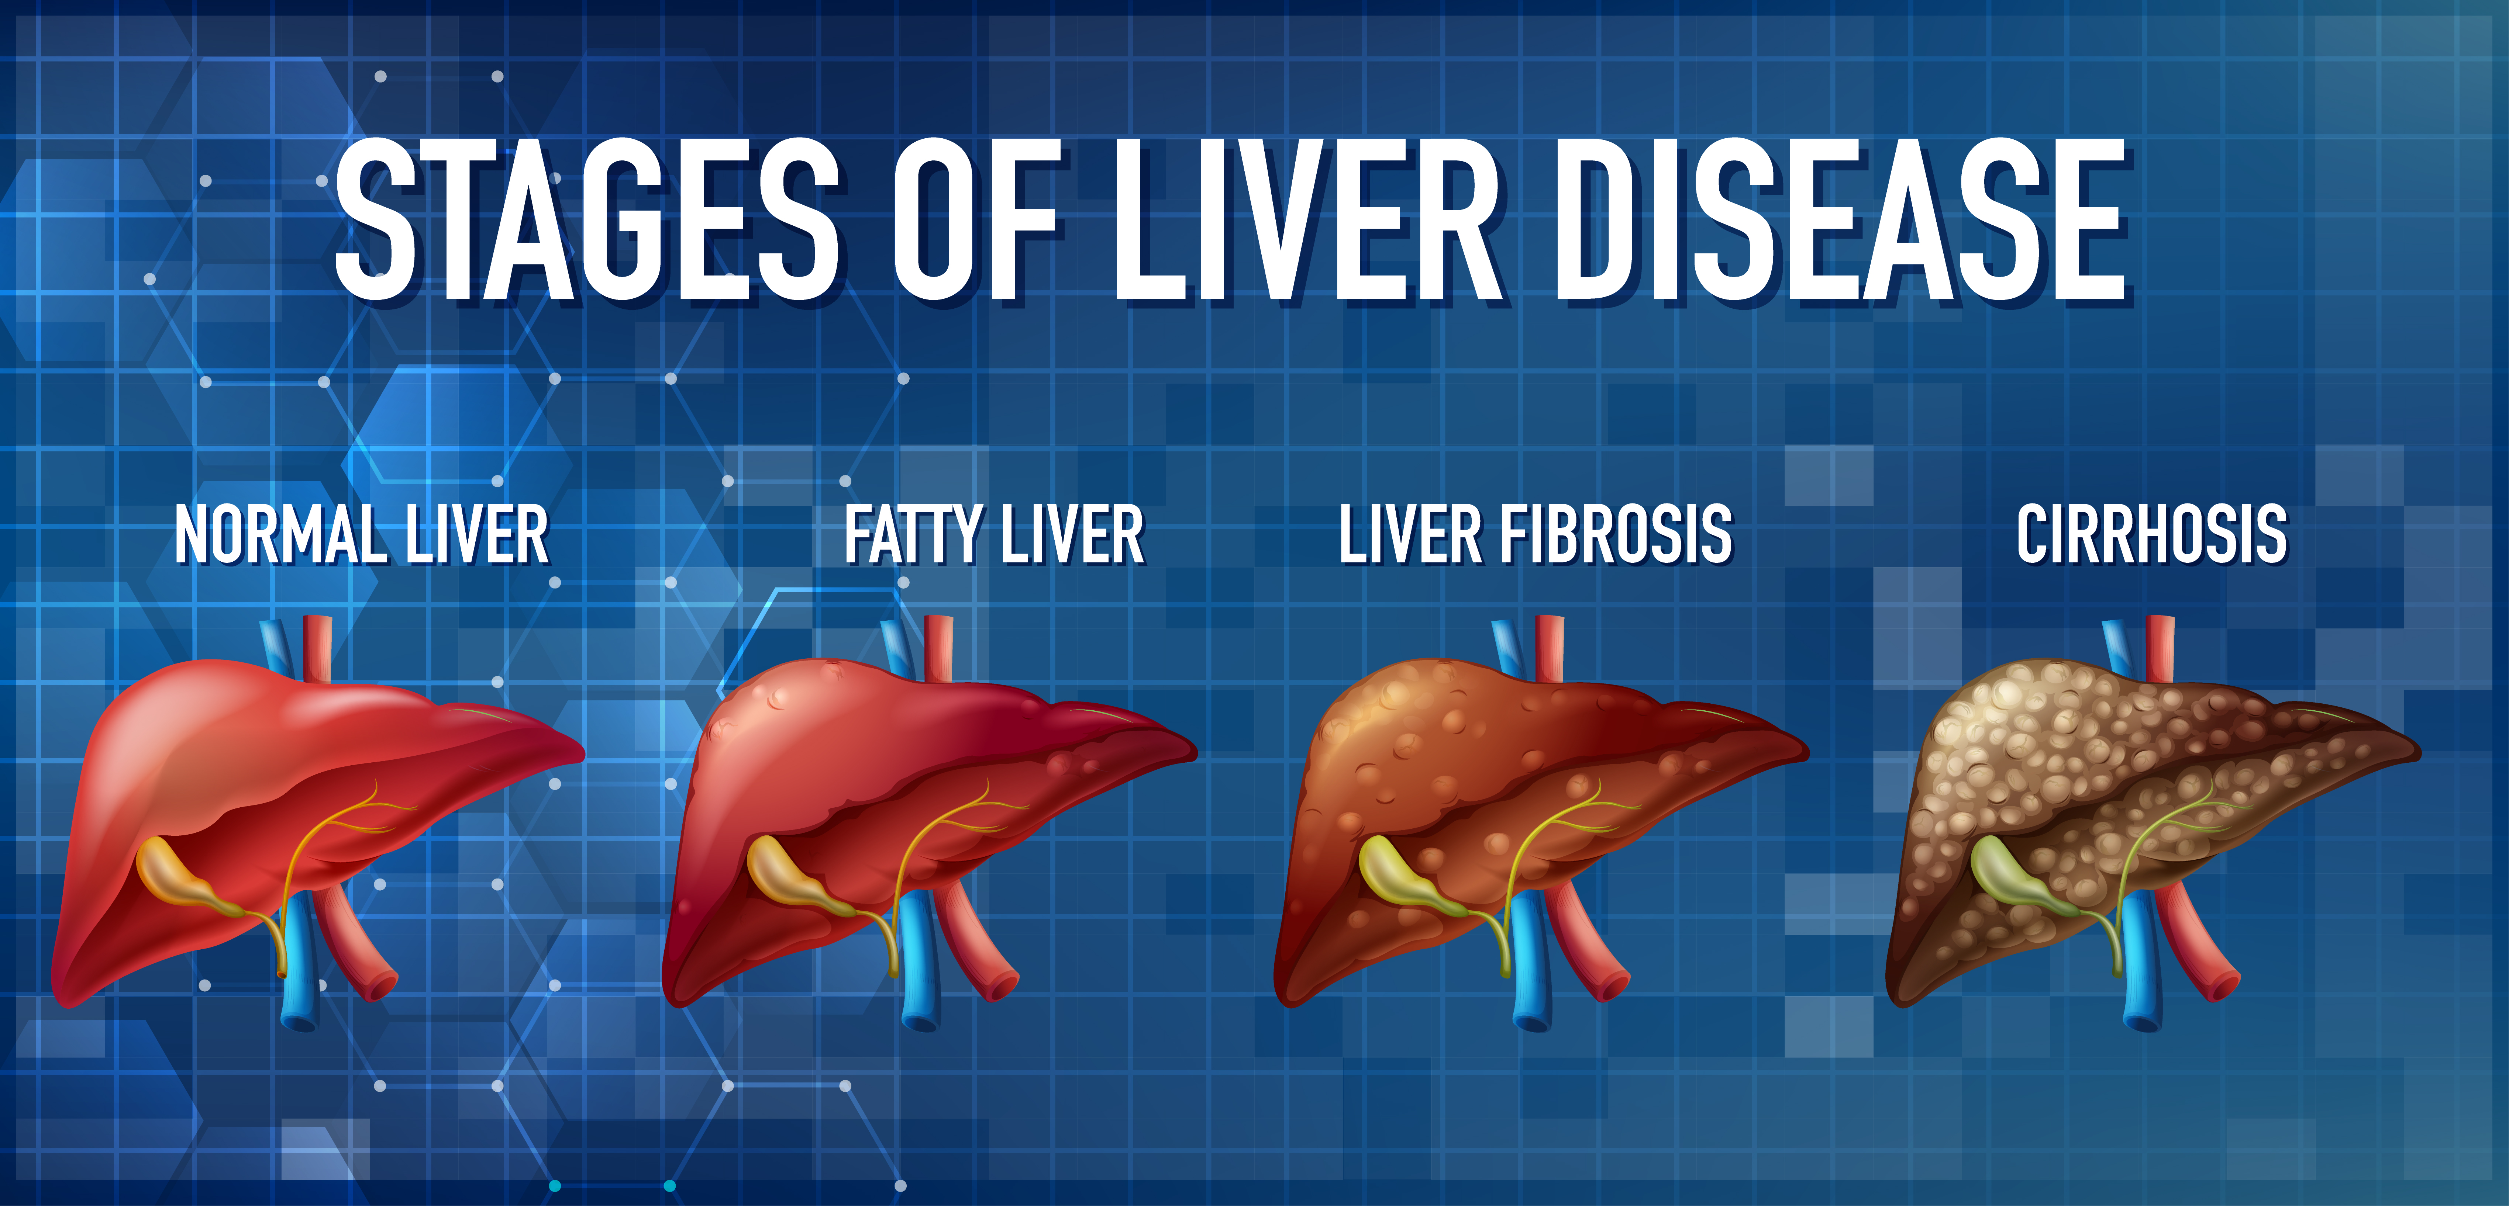
CIRRHOSIS PREDICTION
Machine Learning Algorithms for Classification
Lin Huan Jhe

Slide 2
Tools
Python 3.9
Pandas
HTML/CSS/Bootstrap
Python Matplotlib/Seaborn
MongoDB Atlas
Google Colab
Flask
Anime.js
Scikit-Learn
Gunicorn(Display app.py)
Tensorflow(DL)
Pickle(Export/Import Trained Model)

Slide 3
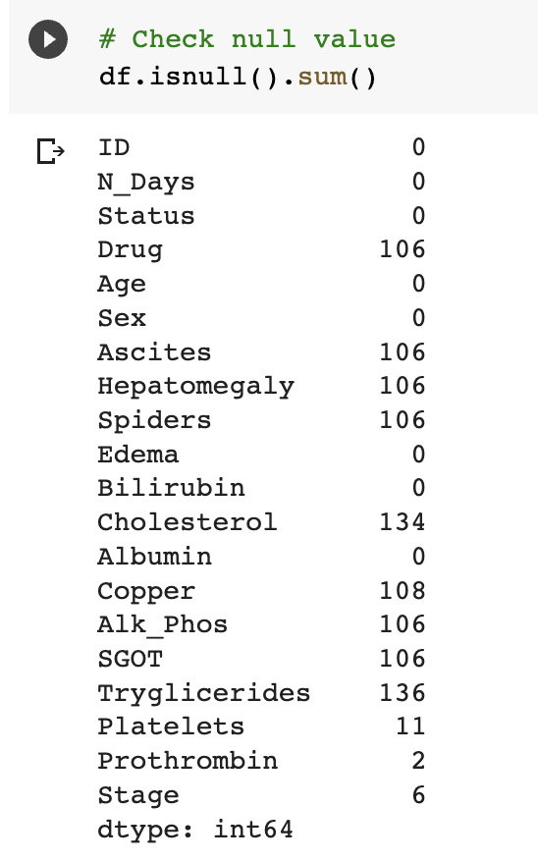
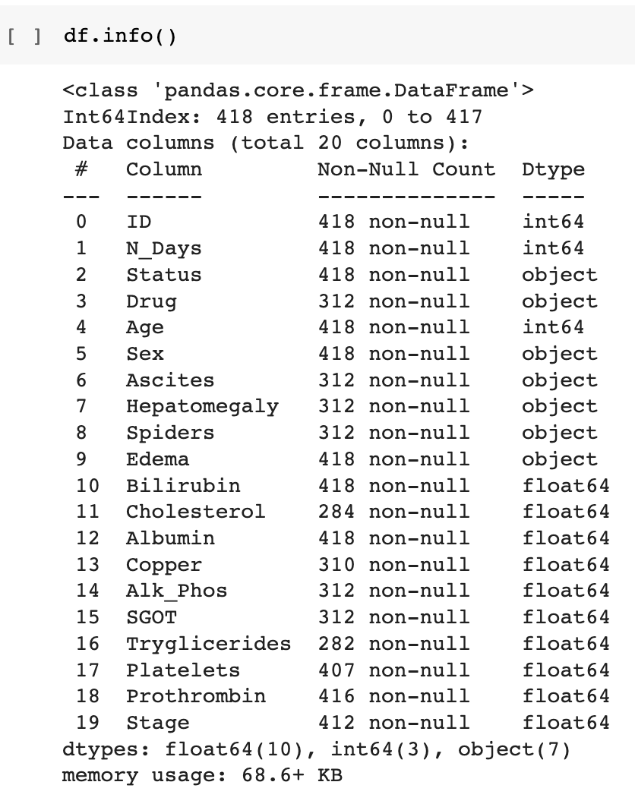
Dataset(Kaggle)

Slide 4
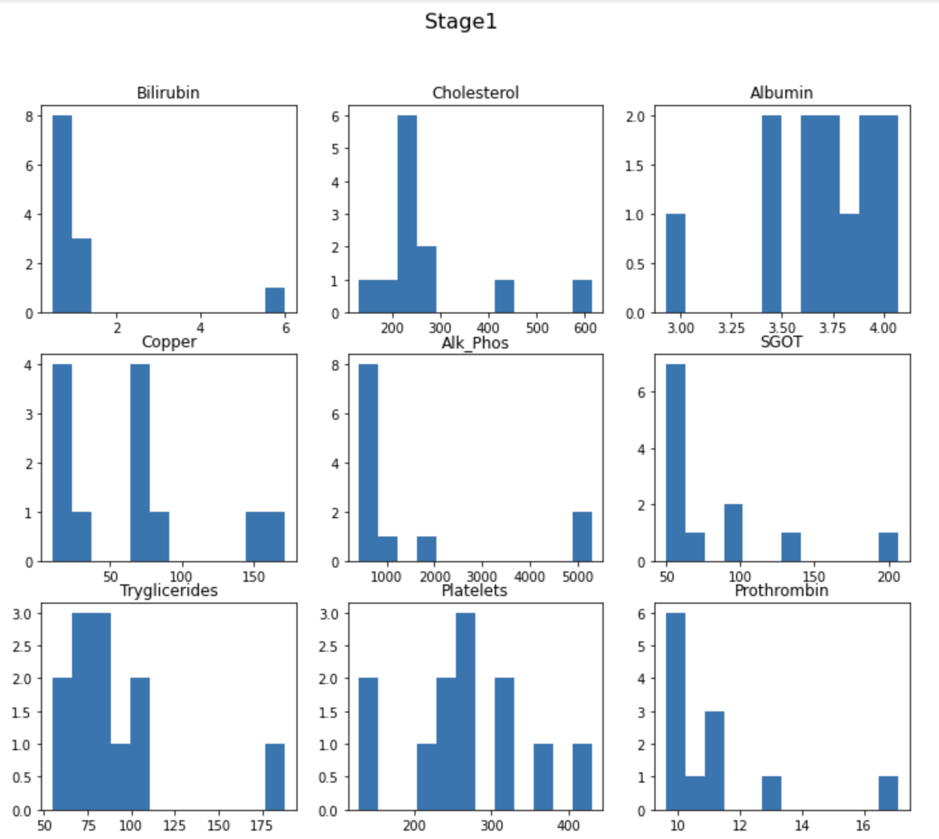
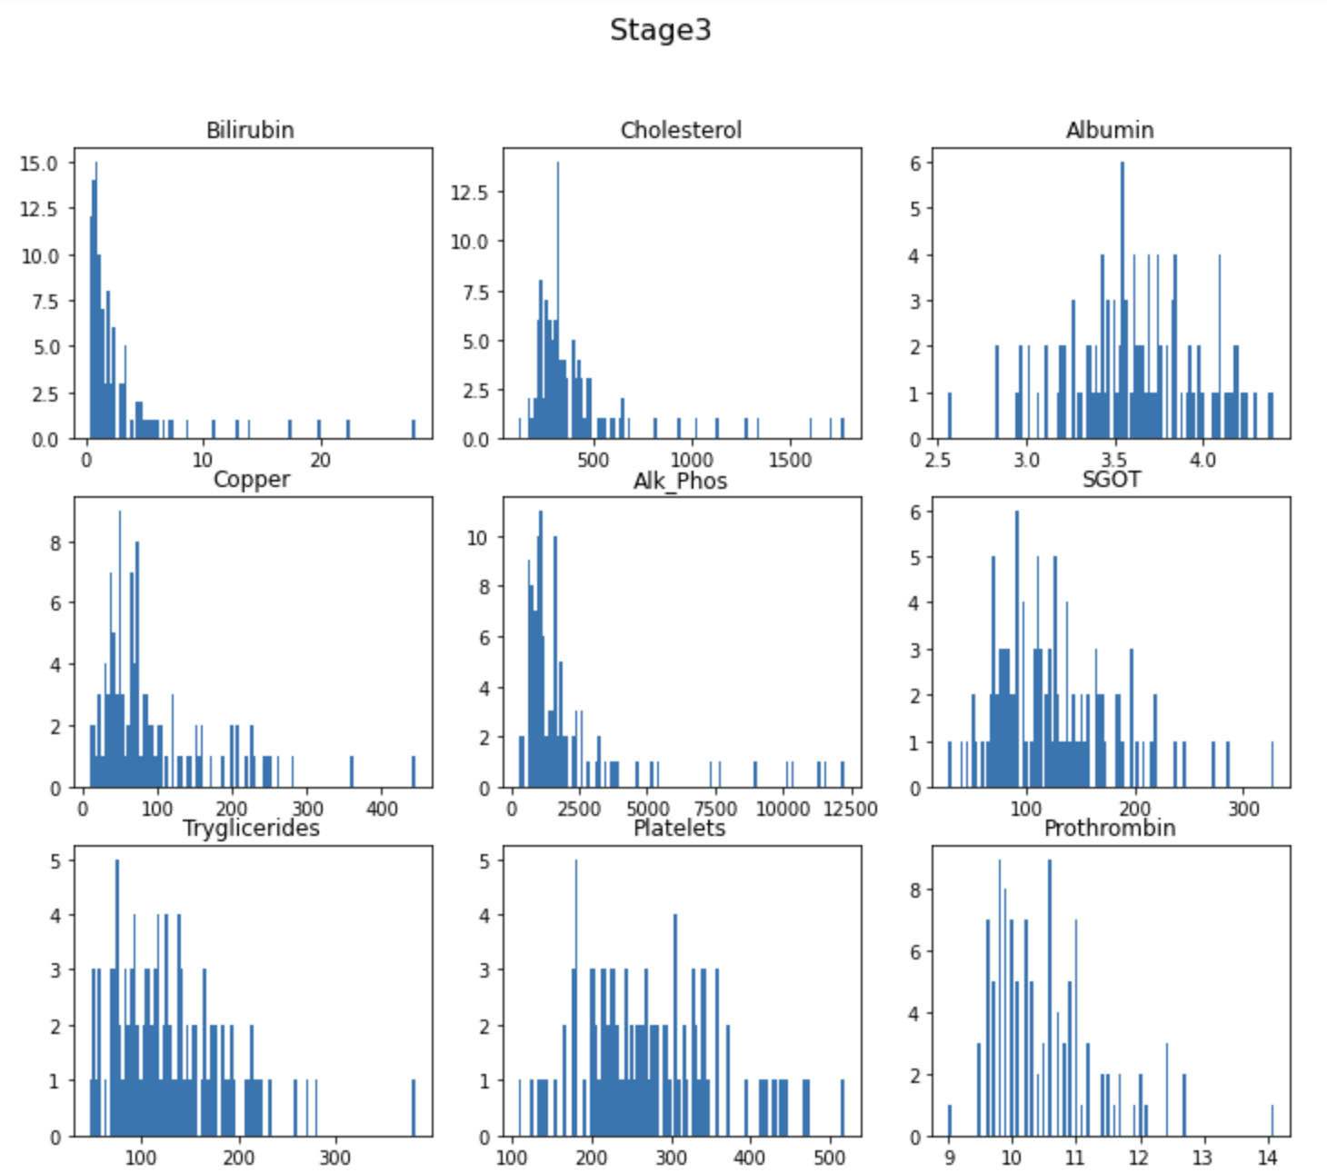
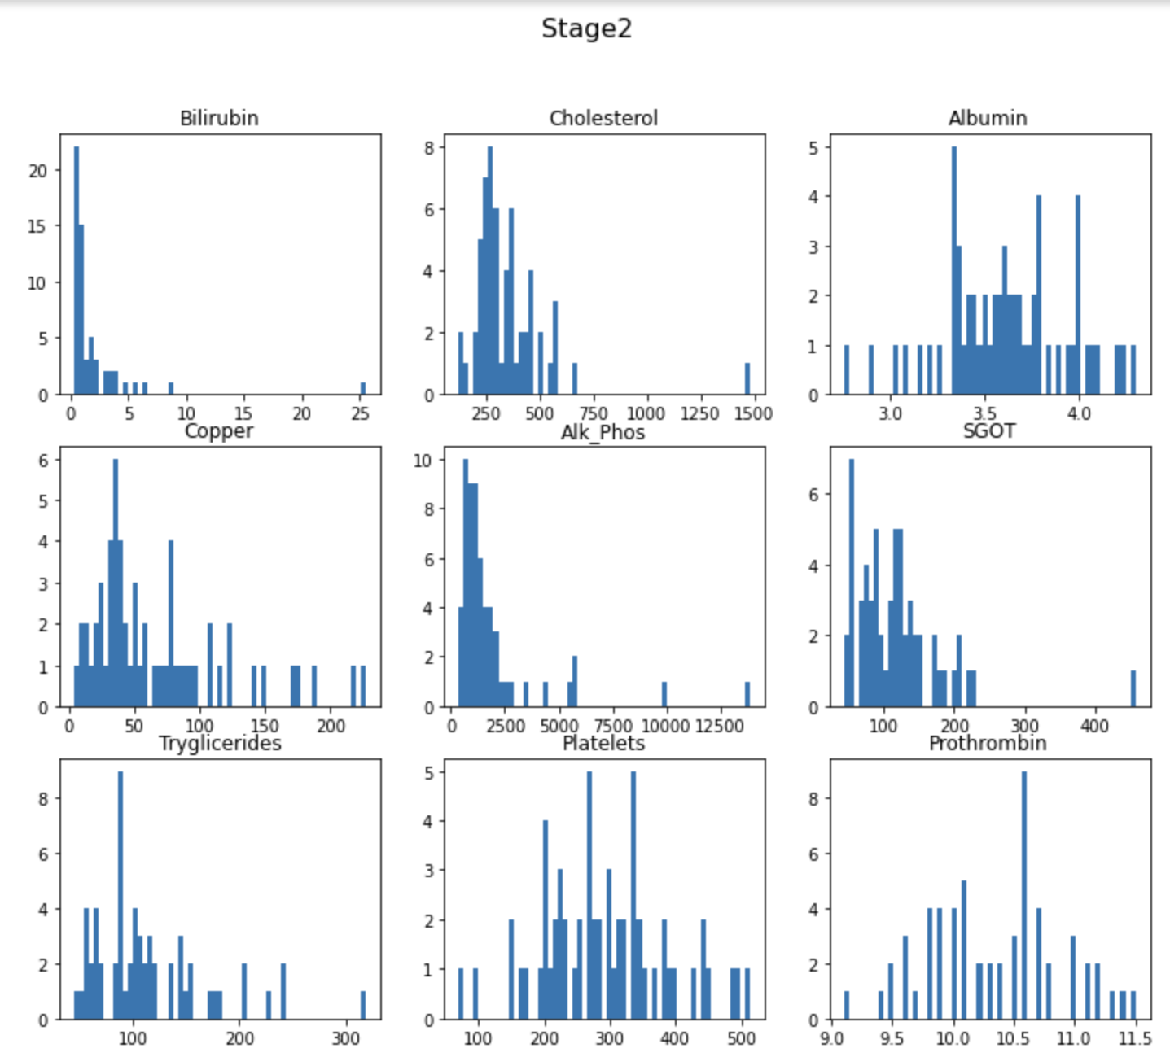
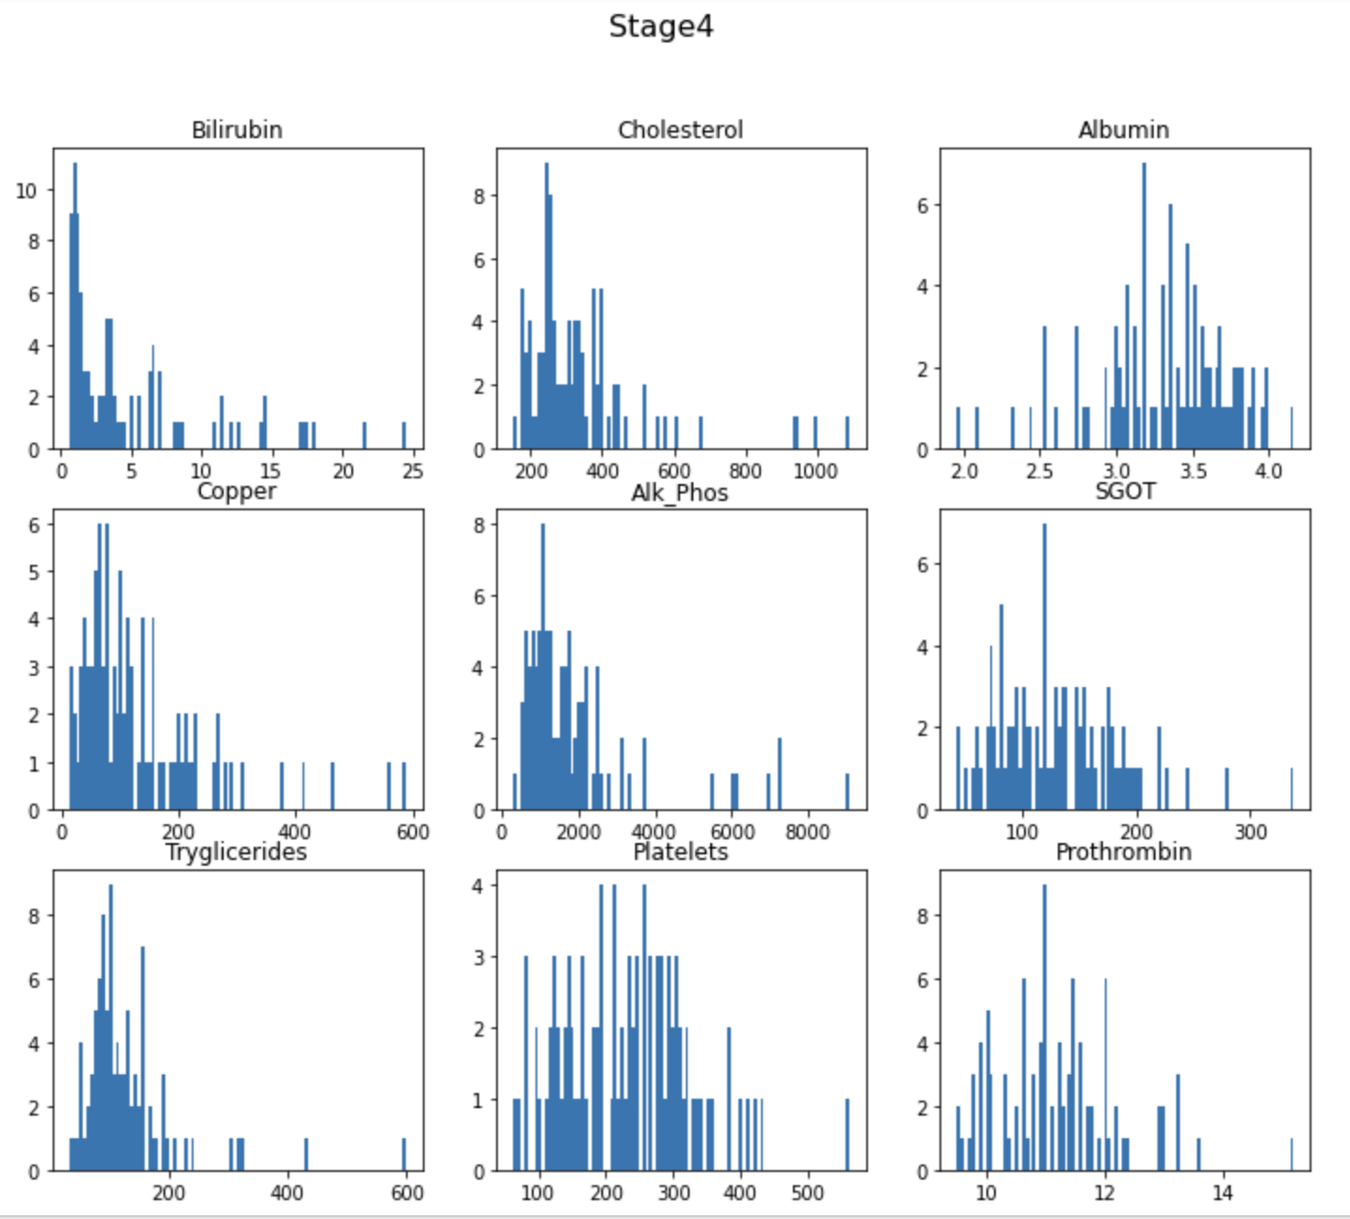
Fill In Null Values

Slide 5
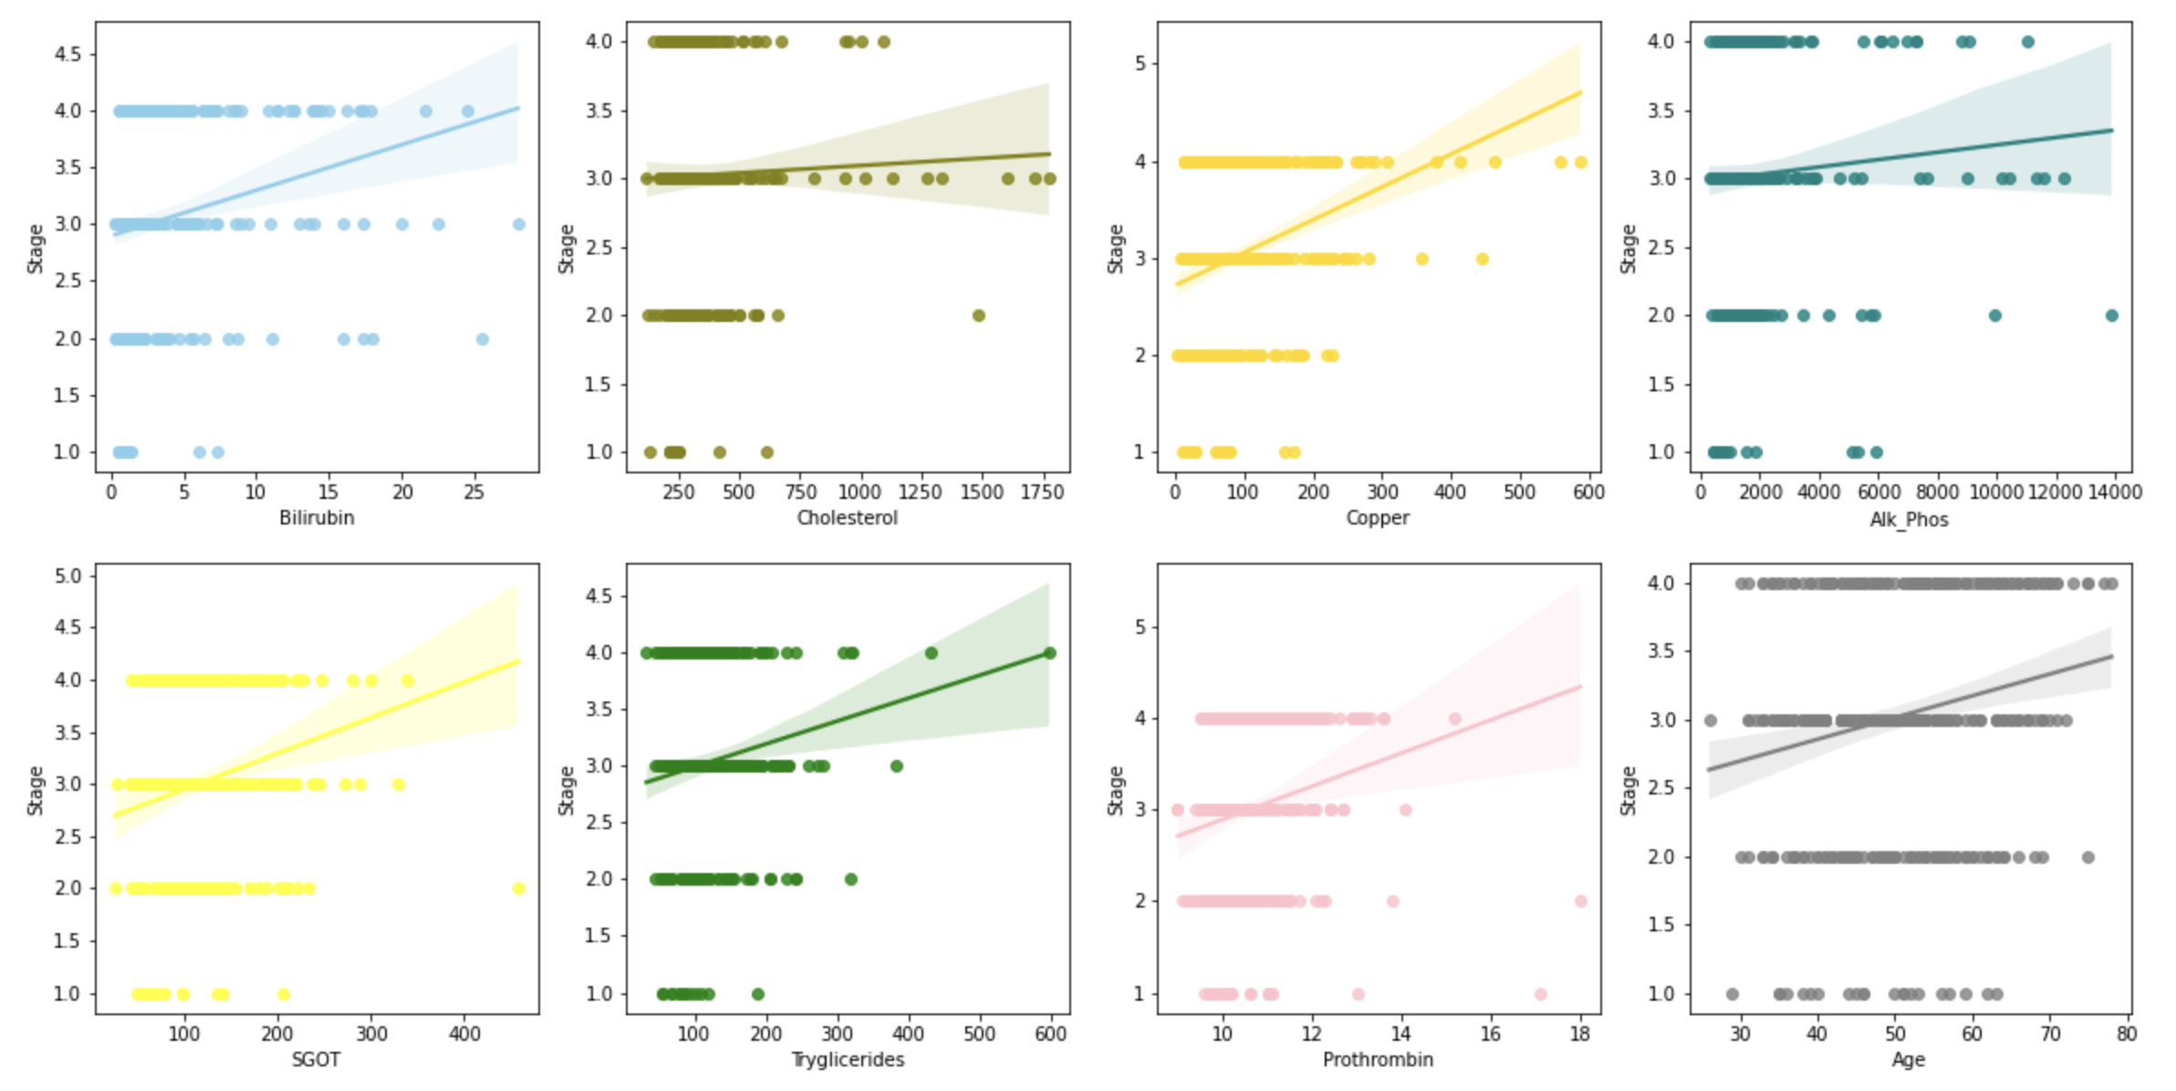
Seaborn-Regplot (Check Linear Relationship Between Numeric features and categories features)

Slide 6
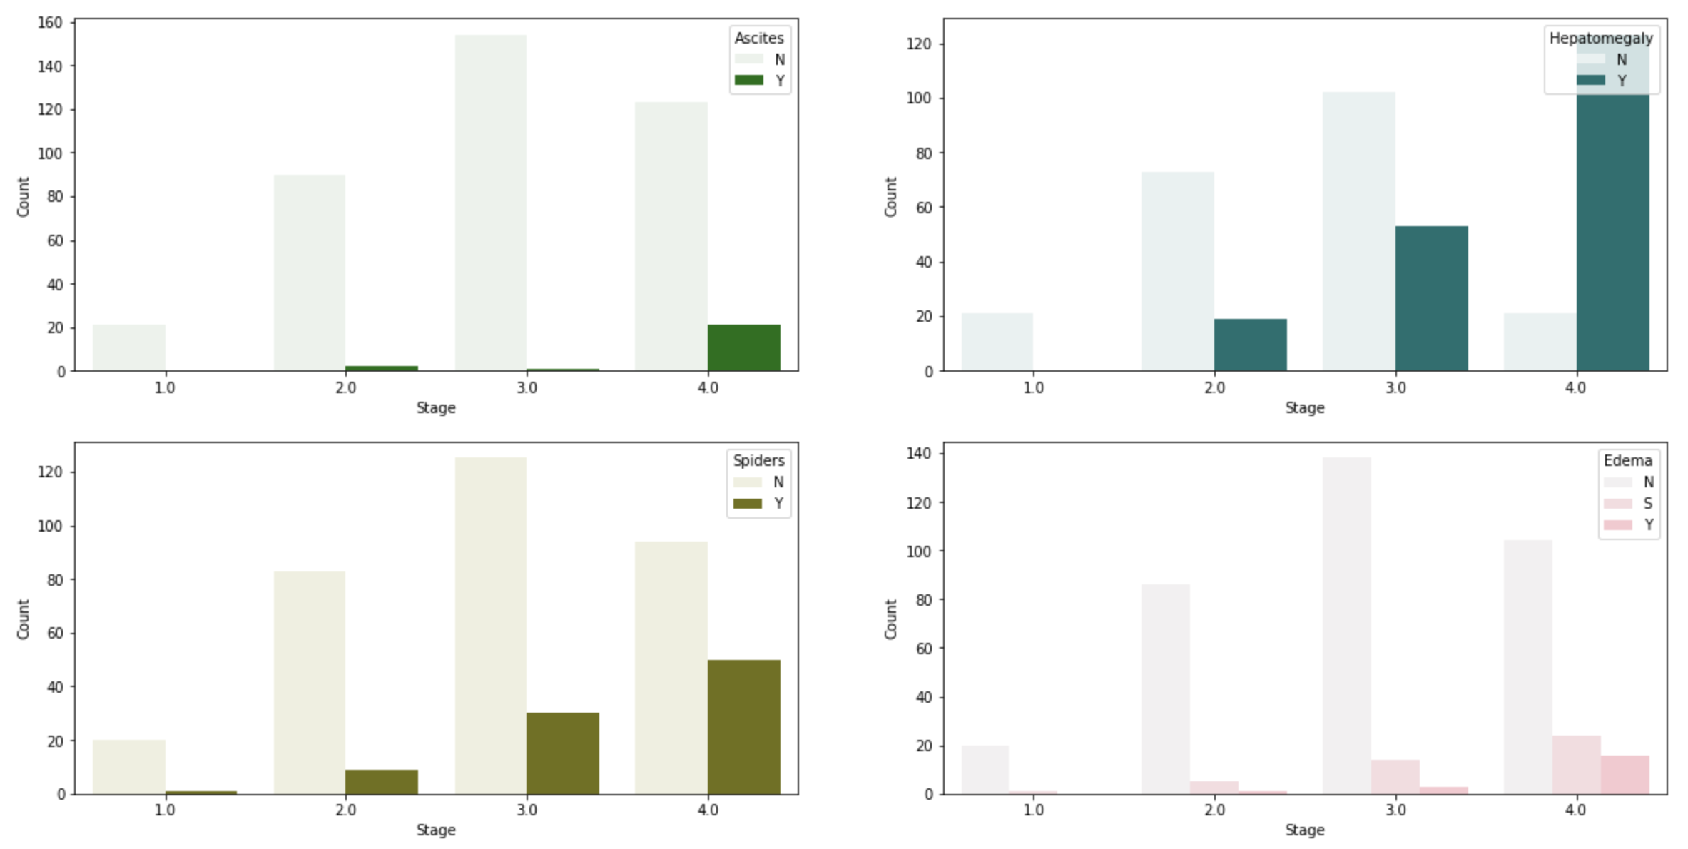
Seaborn-bar (Categories features vs 4 Stages)

Slide 7
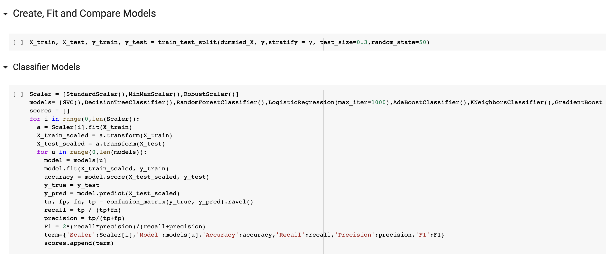
For-Loop Scaler Methods and Classifier Algorithms
Small Data Set-> Higher Percentage Of Test Data

Slide 8
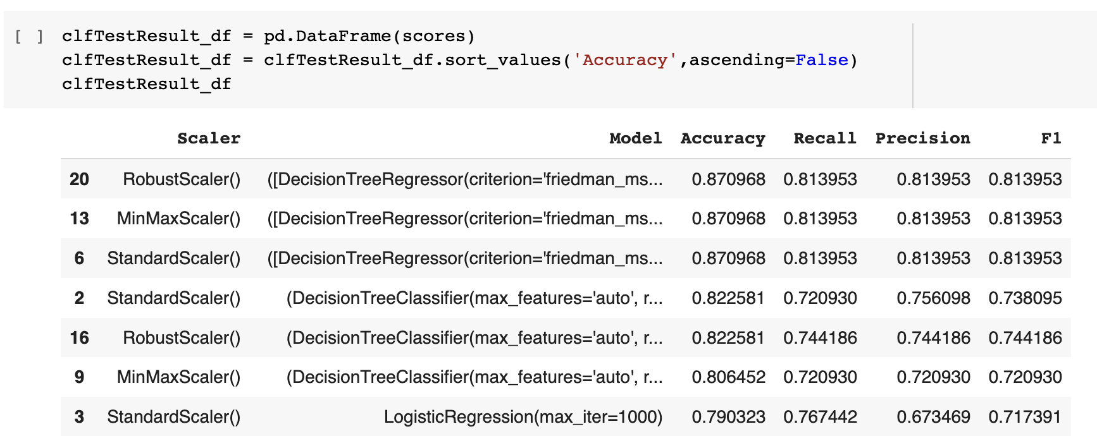
GradientBoostingClassifier Has The Best Accuracy Rate+ Good Recall Rate And Precision Rate

Slide 9
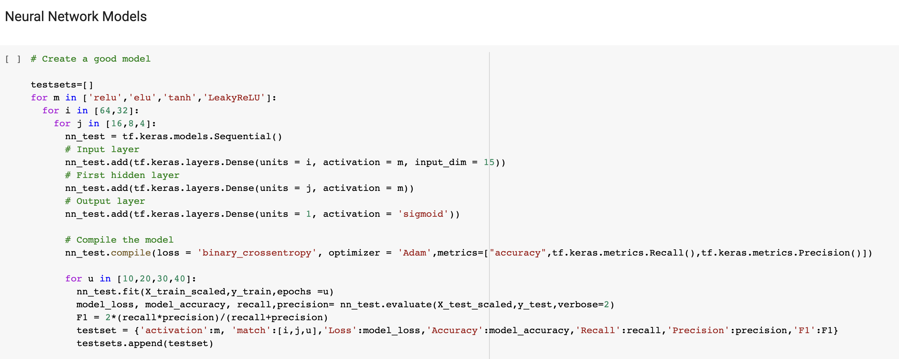
For-Loop Activations, Nodes, and Epochs

Slide 10
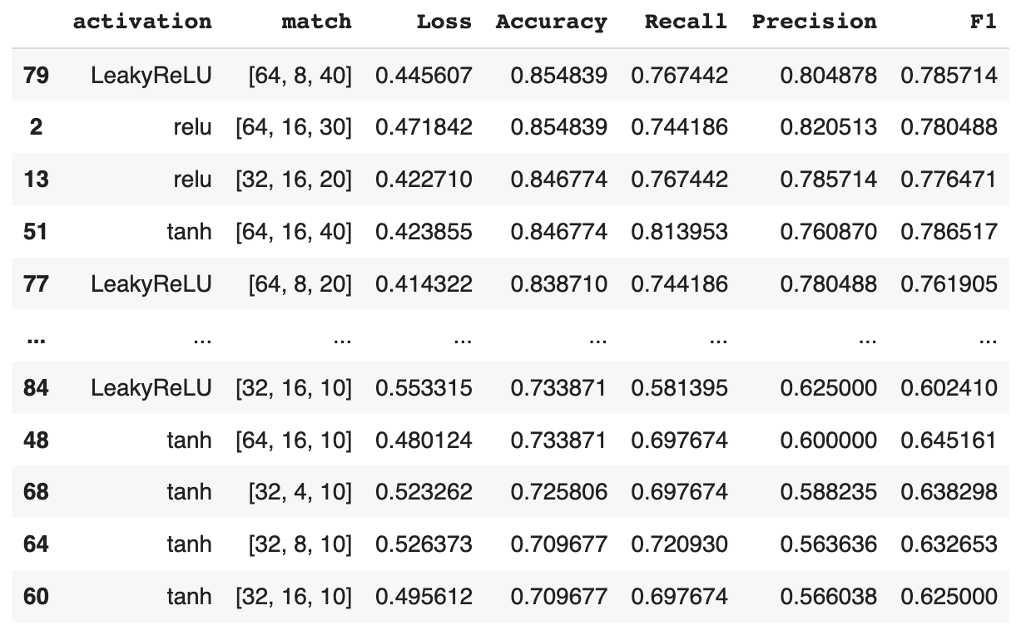
Activation(LeakyReLU) + 64/8 Nodes + 40 Epochs Has The Best Accuracy Rate+ Good Recall Rate And Precision Rate

Slide 11
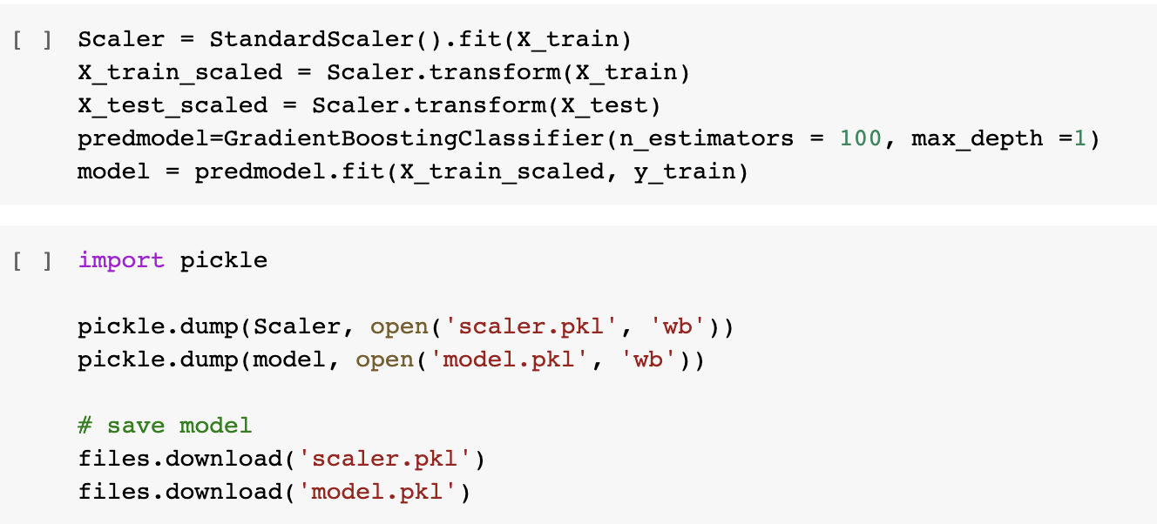
Pickle The Trained Model And The Fitted Scaler

Slide 12
Let’s Have A Look

Slide 13
Thank You For Your Attention

Slide 14


